Slide 1
UR Ticketing System
Developed by: Sri (Last name) and Joel Lesko

Slide 2
Problem & Motivations
Problem: How do we make it easier on maintenance staff to know issues in the facility?
Solution: Create a ticket system similar to those found in IT.
Motivation: Joel’s many summers working as a custodial and maintenance worker for the government.

Slide 3
Main Functions
User:
Make a ticket.
View all tickets in the system.
Up priority of tickets in the system.
View tickets that the user submitted.
Edit an existing ticket.
Employee:
Make a ticket.
View all tickets in the system.
Edit any ticket in the system.
Up priority of tickets in the system.
View tickets that the user submitted.
Edit an existing ticket.

Slide 4
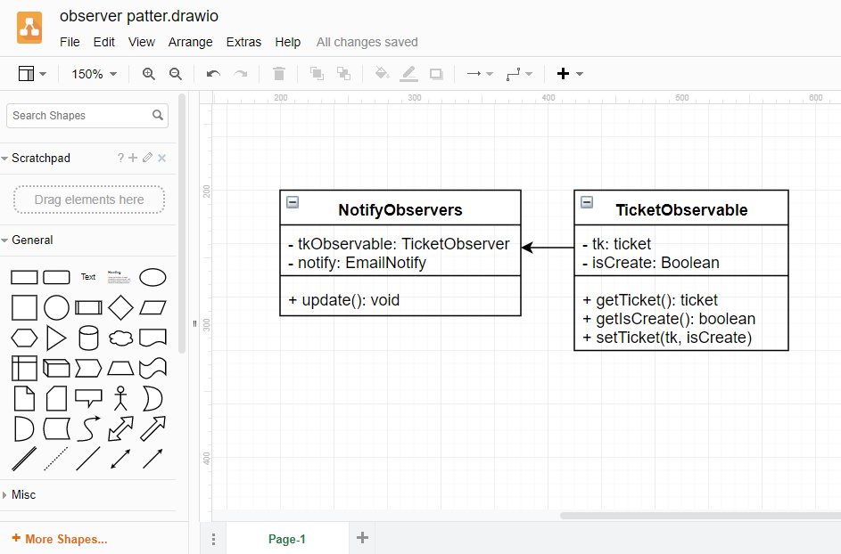
Observer Pattern

Slide 5
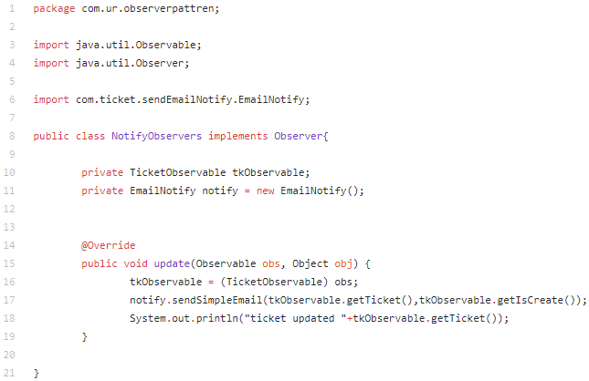
Observer Pattern Code

Slide 6
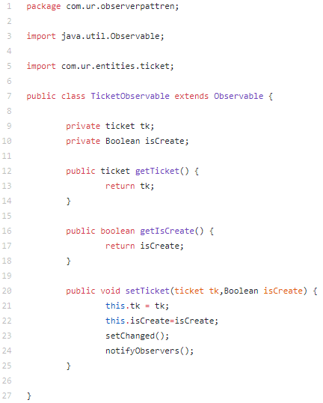
Observer Pattern Code

Slide 7
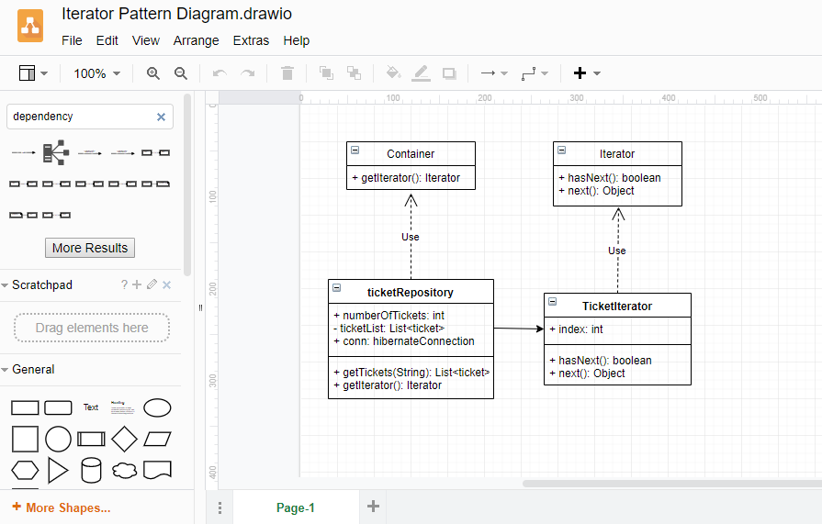
Iterator Pattern

Slide 8
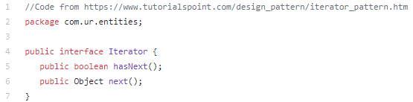
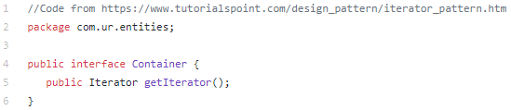
Iterator Pattern Code

Slide 9
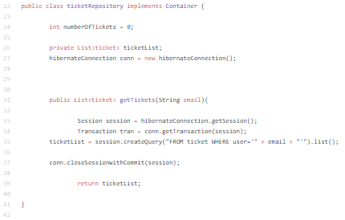
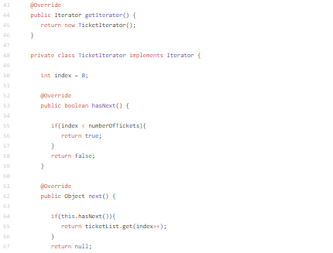
Iterator Pattern Code

Slide 10
Software Development Tools
JavaServer Faces (JSF)
Primary framework of the application.
Hibernate ORM (Hibernate)
Assisted the application with connecting to the database.
BootFaces
Used to primarily help design the front end of the application by making it easier to develop the CSS.
Materialize
Assisted with the design of the front end with helping with the creation of the CSS.

Slide 11
Class Diagram

Slide 12
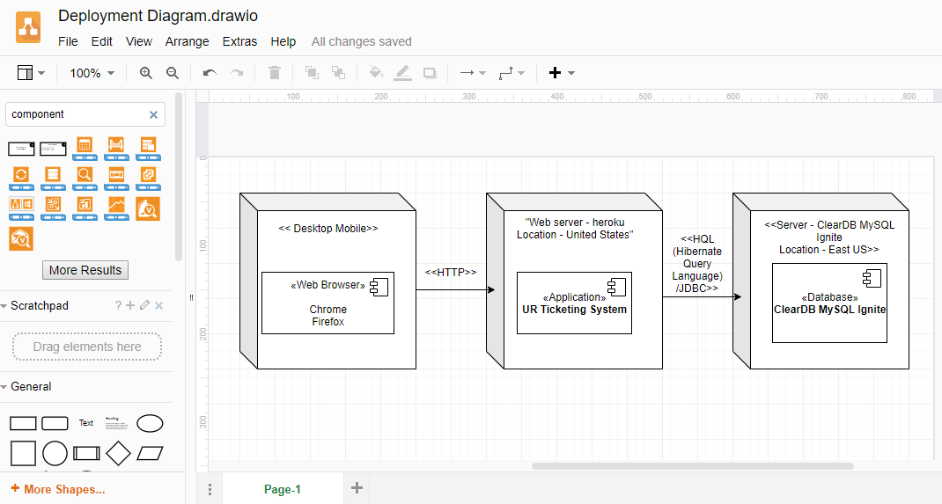
Deployment Diagram

Slide 13
Conclusion

